Slide 1


Classification & Regression Energy Trees with Network Predictors
Gabriel Mesquita Nespoli
Advisor: Prof. Pierpaolo Brutti
Co-Advisor: Dr. Riccardo Giubilei
Pagina 1
Pagina 1
Notes:
1

Slide 2

Main goal

Slide 3
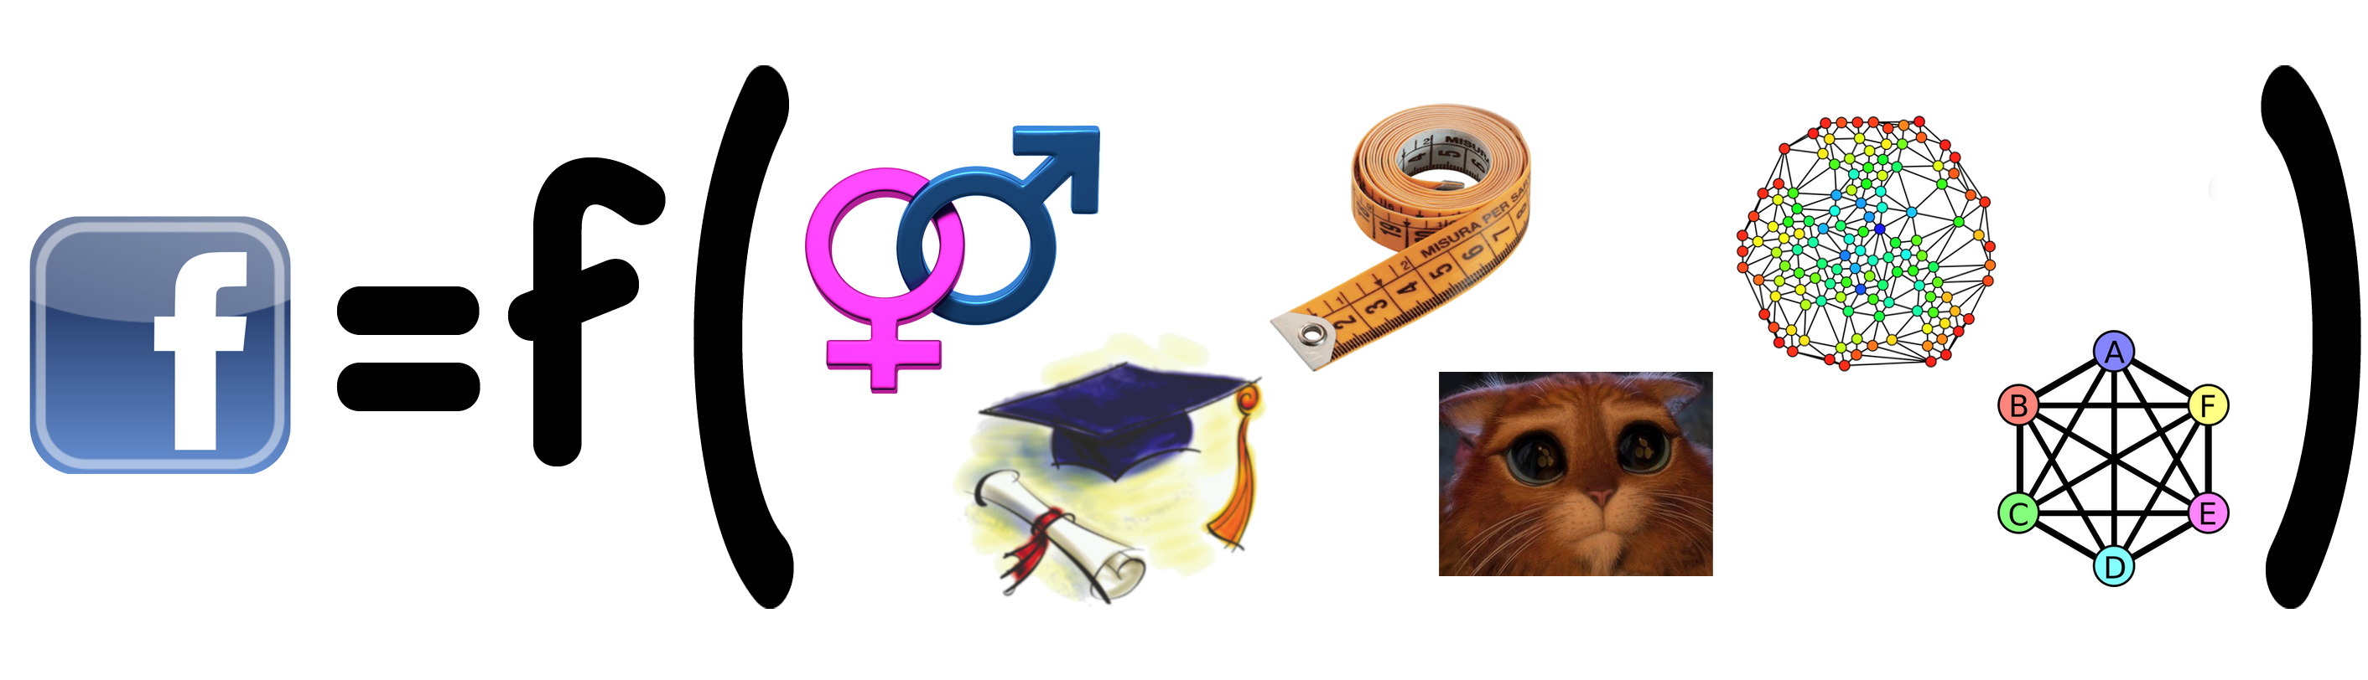
Main goal

Slide 4
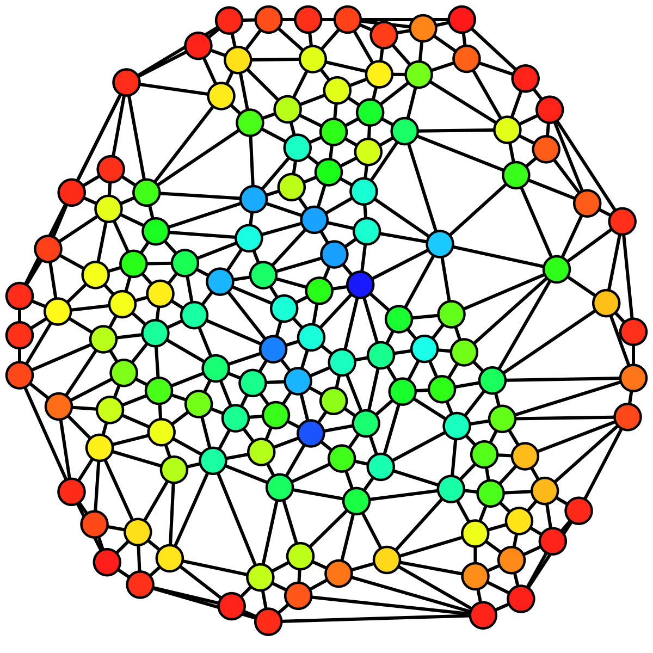
Outline
Introduction
Energy Tree
Distance Covariance and Correlation
Energy Tree on Graphs
Splitting Rule and Stop Condition
Analysis
Conclusions

Slide 5
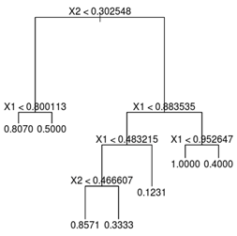
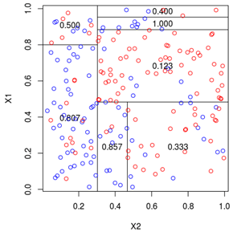
Introduction
CART Decision Tree
Exhaustive search of the split point with Gini impurity (classification) or Variance (regression).
Biased selection of variables.
Conditional Inference Tree
Avoids exhaustive search by selecting the covariate most associated to the response by running association tests.
None of these methods is general enough to work with complex explanatory variables like functions or networks.

Slide 6
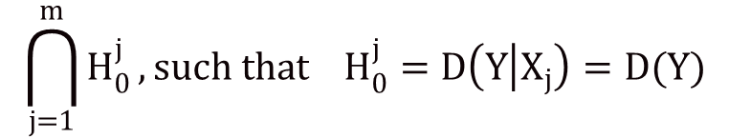

Conditional Inference Tree
Step 1: global test if there is association between Y and ${\{X_{k}\}}_{k=1,…,p}$
Step 2: choose the feature associated to the minimum p-value
Step 3: split data into two subsets in the point that minimizes the variance of Y in the subsets
Step 4: iterate from step 1 to 4 on the two subsets
Problem: it’s hard to measure the association between data of different nature
Energy statistics gives us a unified framework to measure association
between complex as well as simple objects possibly different in nature
$$\bigcap_{j=1}^{m}{H_{0}^{j}}, such that H_{0}^{j}=D\left(Y | X_{j}\right)=D(Y)$$

Slide 7
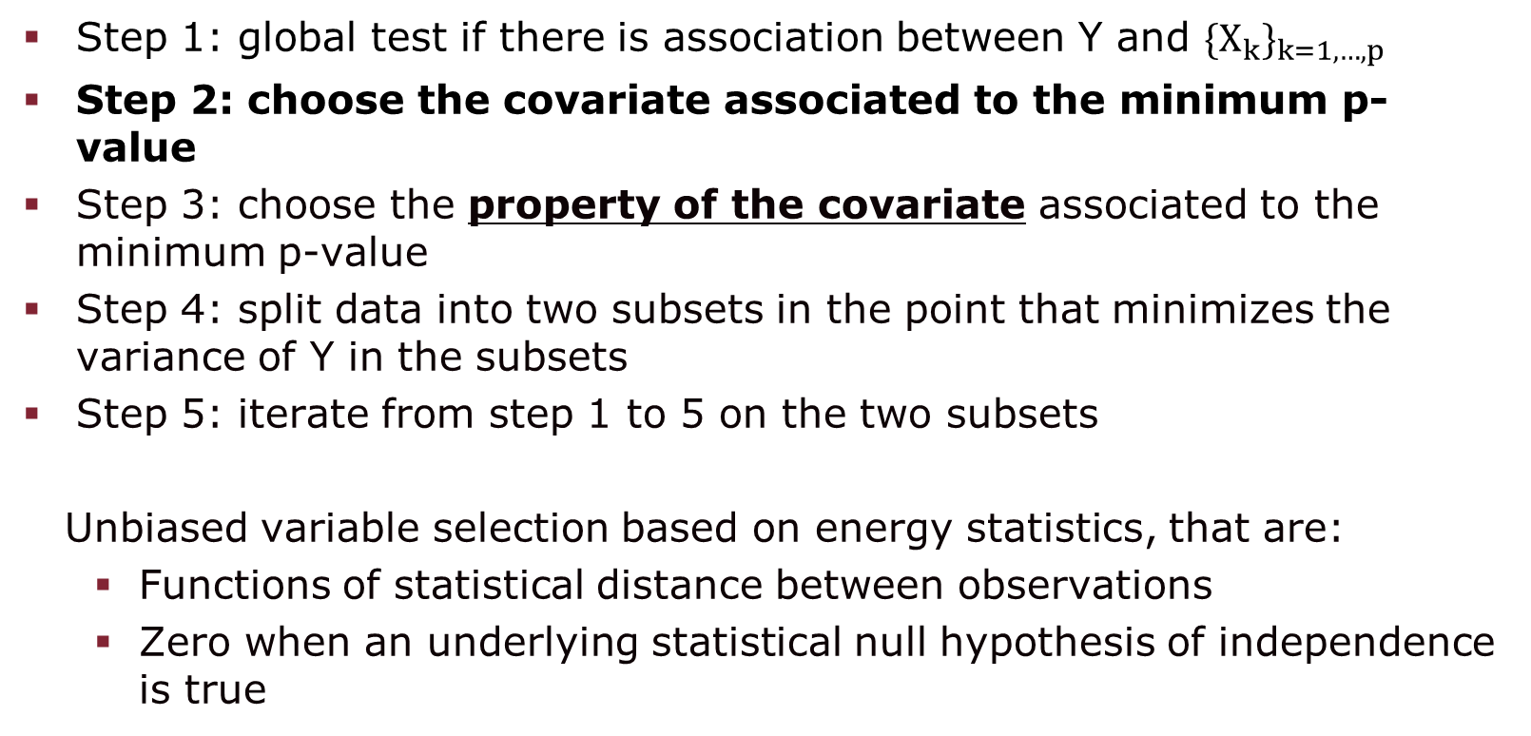
Energy Trees Algorithm (I)
Step 1: global test if there is association between Y and ${\{X_{k}\}}_{k=1,…,p}$
Step 2: choose the covariate associated to the minimum p-value
Step 3: choose the property of the covariate associated to the minimum p-value
Step 4: split data into two subsets in the point that minimizes the variance of Y in the subsets
Step 5: iterate from step 1 to 5 on the two subsets
Unbiased variable selection based on energy statistics, that are:
Functions of statistical distance between observations
Zero when an underlying statistical null hypothesis of independence is true

Slide 8

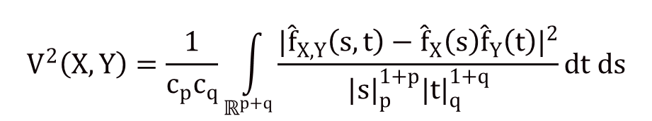
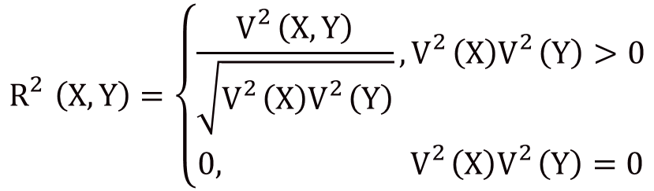
Distance Covariance & Correlation
dCor is a measure of independence of two random variables
Problem with p(X,Y):
dCor does guarantee independence when it is equal to 0
R(X,Y) is a bona fide measure of independence
$$R_{}^{2}\left(X,Y\right)=\left\{\begin{aligned}\frac{V_{}^{2}\left(X,Y\right)}{\sqrt{V_{}^{2}\left(X\right)V_{}^{2}\left(Y\right)}},V_{}^{2}\left(X\right)V_{}^{2}\left(Y\right)>0 \\ 0, V_{}^{2}\left(X\right)V_{}^{2}\left(Y\right)=0\end{aligned}\right.$$
$$V^{2}\left(X,Y\right)=\frac{1}{c_{p}c_{q}}\int_{ℝ^{p+q}}{\frac{{|{\hat{f}}_{X,Y}\left(s,t\right)−{\hat{f}}_{X}\left(s\right){\hat{f}}_{Y}\left(t\right)|}^{2}}{{|s|}_{p}^{1+p}{|t|}_{q}^{1+q}}}dt ds$$

Slide 9
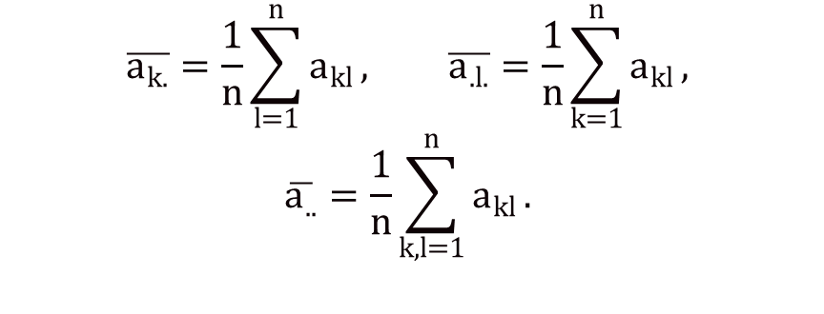
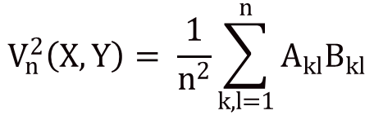
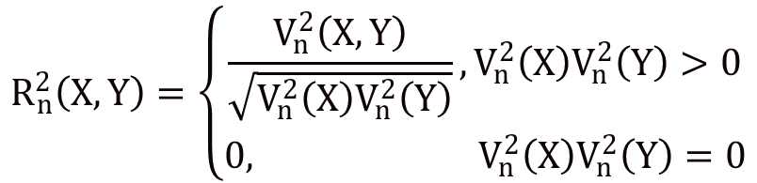
Sample Distance Covariance & Correlation
$${dCov}^{2}\left(X,Y\right)=E\left[\left|X−X^{′}\right|\left|Y−Y^{′}\right|\right]+E\left[\left|X−X^{′}\right|] E[\left|Y−Y^{′}\right|\right]−2E[\left|X−X^{′}\right|\left|Y−Y^{′′}\right|]$$
$$V_{n}^{2}\left(X,Y\right)= \frac{1}{n^{2}}\sum_{k,l=1}^{n}{A_{kl}B_{kl}}$$
$$A_{kl}=a_{kl}−\overline{a_{k.}}−{\overline{a}}_{.l}−\overline{a_{..}} k,l=1,…,n$$
, such that
$$R_{n}^{2}\left(X,Y\right)=\left\{\begin{aligned}\frac{V_{n}^{2}\left(X,Y\right)}{\sqrt{V_{n}^{2}\left(X\right)V_{n}^{2}\left(Y\right)}},V_{n}^{2}\left(X\right)V_{n}^{2}\left(Y\right)>0 \\ 0, V_{n}^{2}\left(X\right)V_{n}^{2}\left(Y\right)=0\end{aligned}\right.$$

Slide 10
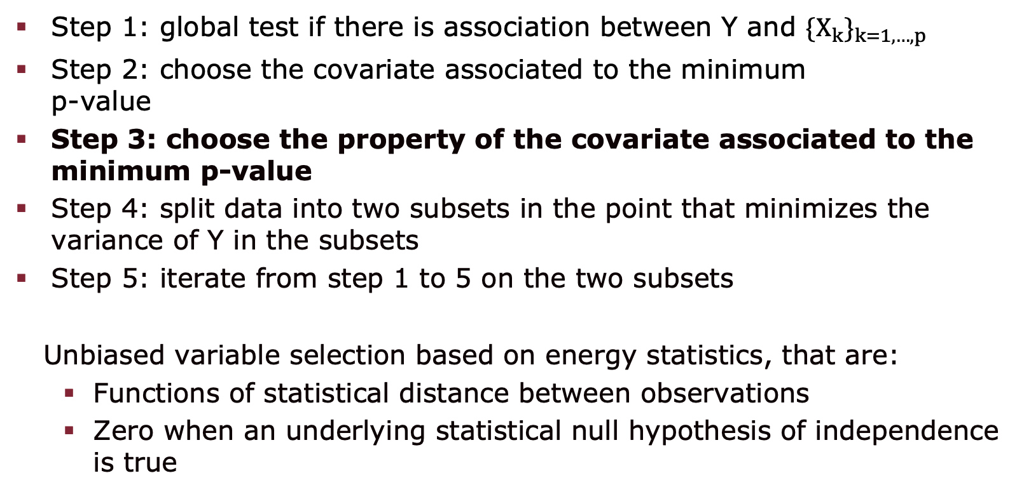
Energy Trees Algorithm (II)
Step 1: global test if there is association between Y and ${\{X_{k}\}}_{k=1,…,p}$
Step 2: choose the covariate associated to the minimum p-value
Step 3: choose the property of the covariate associated to the minimum p-value
Step 4: split data into two subsets in the point that minimizes the variance of Y in the subsets
Step 5: iterate from step 1 to 5 on the two subsets
Unbiased variable selection based on energy statistics, that are:
Functions of statistical distance between observations
Zero when an underlying statistical null hypothesis of independence is true

Slide 11

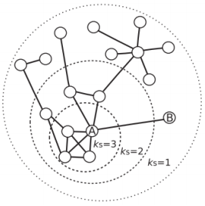
Energy Trees for Graph Covariates
K-core decomposition
K-shell
Degeneracy: highest k-core
Shell index distribution vector
n(g) = (0,10,3,4,0,0,0,0,0,0,0,0,0,0,0,0,0)
...all graphs
Shell index distribution matrix
0-shell | 1-shell | 2-shell | 3-shell | 4-shell | 5-shell
0 | 10 | 3 | 4 | 0 | 0
2 | 5 | 4 | 1 | 0 | 0
0 | 0 | 0 | 7 | 5 | 12
... | ... | ... | ... | ... | ...

Slide 12
Analysis - Simulation studies
Classification problem
50 runs
100 bipartite x 100 ER-random graphs
80:20 training/test set ration
Method | Mean Acc.
Classification Energy Tree | 0.7400
CART | 0.7390
Ctree | 0.7295
Regression problem
50 runs
100 bipartite + 100 ER-random graphs
Y ~ N(10,2) Y ~ N(30,3)
80:20 training/test set ration
Method | MRMSE
Regression Energy Tree | 8.5071
CART | 8.7025
Ctree | 10.4867

Slide 13
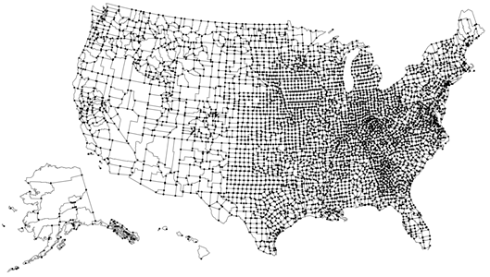
Analysis – Topology of roads / fatal vehicle crashes (FVC)
0-shell | 1-shell | 2-shell | 3-shell | 4-shell | # FVC
0 | 30495 | 38562 | 25 | 0 | 75
0 | 187281 | 379310 | 252 | 0 | 864
0 | 156358 | 362440 | 377 | 0 | 457
0 | 151885 | 392486 | 376 | 4 | 919
0 | 469050 | 1143306 | 969 | 0 | 3304
0 | 137967 | 309849 | 696 | 11 | 600
Method | RMSE
Regression Energy Tree | 457.09
CART | 476.83
Ctree | 567.03
51 observations
80:20 training/test set ratio

Slide 14
Conclusions
Extended the Energy Tree to work with network covariates
High efficient tree-based method
Best performing algorithm in 70% of all analyses
Allow weights on edges or nodes
Alternative k-core decomposition to work with directed graphs
Real case with both functional and network data
Future work

Slide 15
THANK YOU! QUESTIONS?

